Slide 1
Artificial Intelligence
LECTURE: 6

Slide 2
Problem-solving agents:
In Artificial Intelligence, Search techniques are universal problem-solving methods.
Rational agents or Problem-solving agents in AI mostly used these search strategies or algorithms to solve a specific problem and provide the best result.
Problem-solving agents are the goal-based agents and use atomic representation.

Slide 3
Search Algorithm Terminologies:
Search: Searching is a step by step procedure to solve a search-problem in a given search space. A search problem can have three main factors:
  Search Space: Search space represents a set of possible solutions, which a system may have.
  Start State: It is a state from where agent begins the search.
  Goal test: It is a function which observe the current state and returns whether the goal state is achieved or not.
Search tree: A tree representation of search problem is called Search tree. The root of the search tree is the root node which is corresponding to the initial state.
Actions: It gives the description of all the available actions to the agent.
Transition model: A description of what each action do, can be represented as a transition model.
Path Cost: It is a function which assigns a numeric cost to each path.
Solution: It is an action sequence which leads from the start node to the goal node.
Optimal Solution: If a solution has the lowest cost among all solutions.

Slide 4
Properties of Search Algorithms
Following are the four essential properties of search algorithms to compare the efficiency of these algorithms:
Completeness: A search algorithm is said to be complete if it guarantees to return a solution if at least any solution exists for any random input.
Optimality: If a solution found for an algorithm is guaranteed to be the best solution (lowest path cost) among all other solutions, then such a solution for is said to be an optimal solution.
Time Complexity: Time complexity is a measure of time for an algorithm to complete its task.
Space Complexity: It is the maximum storage space required at any point during the search, as the complexity of the problem.

Slide 5
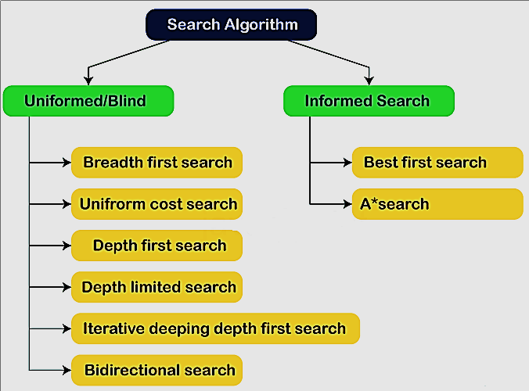
Types of search algorithms

Slide 6
Uninformed/Blind Search:
Uninformed search, also known as blind search, operates without domain-specific knowledge, such as goal location or closeness.
It explores the search space in a brute-force manner, relying only on traversal rules and goal identification.
These algorithms systematically examine each node without any heuristic guidance, ensuring a thorough but potentially inefficient search.

Slide 7
Breadth-first Search:
Breadth-first search is the most common search strategy for traversing a tree or graph. This algorithm searches breadthwise in a tree or graph, so it is called breadth-first search.
BFS algorithm starts searching from the root node of the tree and expands all successor node at the current level before moving to nodes of next level.
The breadth-first search algorithm is an example of a general-graph search algorithm.
Breadth-first search implemented using FIFO queue data structure.

Slide 8
BFS-Algorithm
Enter starting node in Queue.
If Queue is empty then return fail and stop.
If first element in the Queue is goal node then return success and stop.
Else remove and expand first element from Queue and place it’s child in the end of the Queue.
Go to step 3.

Slide 9
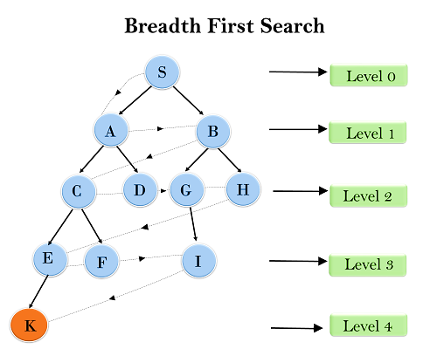
Example

Slide 10
Time Complexity in BFS
BFS explores the tree level by level, meaning it visits all nodes at one level before moving to the next.
Suppose each node has b children (branching factor).
The shallowest goal node is found at depth d.
The total number of nodes BFS visits before reaching depth d is:
T(b) = 1 + b + b² + b³ + ... + b^{d}
This forms a geometric series, and in Big-O notation, we express it as:
O(b^{d})
Example:
  If each node has b = 2 children (binary tree) and the goal is at depth d = 5,
  The number of nodes BFS explores is roughly:
  1 + 2 + 4 + 8 + 16 + 32 = 63 = O(2⁵)
  As depth d increases, the number of explored nodes grows exponentially.

Slide 11
Space Complexity of BFS
BFS keeps track of all the nodes at the current level before moving to the next level.
At depth d, there are about b^{d} nodes in the worst case.
The amount of memory BFS needs is proportional to the number of nodes at the last level:
O(b^{d})
Example:
  If each node has b = 2 children and the search depth is d = 5,
  The last level contains b^{d} = 2⁵ = 32 nodes, meaning we need memory to store 32 nodes at once.
  This makes BFS memory-intensive compared to other search algorithms like DFS.

Slide 12
Completeness of BFS
BFS is guaranteed to find a solution if one exists.
Since it searches level by level, it always finds the shallowest (nearest) goal node first.
Example:
  Imagine searching for a name in a family tree.
  BFS will check parents first, then children, then grandchildren, etc.
  If the person you are looking for is at level 3, BFS will not skip it and will find it as soon as it reaches level 3.
BFS is complete! It will always find the goal if there is a solution.

Slide 13
Optimality of BFS
BFS is optimal if the path cost is a non-decreasing function of depth.
This means if all step costs are equal, BFS always finds the shortest path first.
Example:
  Consider a road network where every road segment has an equal cost (e.g., every road is 1 km long).
  BFS finds the shortest path in terms of the fewest number of roads because it finds the goal at the shallowest depth.
  However, if roads have different lengths (e.g., some are highways, some are small streets), BFS may not be optimal because it does not consider cost.
BFS is optimal if all steps have equal cost!

Slide 14
Advantages:
BFS will provide a solution if any solution exists.
If there are more than one solutions for a given problem, then BFS will provide the minimal solution which requires the least number of steps.
It also helps in finding the shortest path in goal state, since it needs all nodes at the same hierarchical level before making a move to nodes at lower levels.

Slide 15
Disadvantages:
It requires lots of memory since each level of the tree must be saved into memory to expand the next level.
BFS needs lots of time if the solution is far away from the root node.
It can be very inefficient approach for searching through deeply layered spaces, as it needs to thoroughly explore all nodes at each level before moving on to the next

